Slide 1

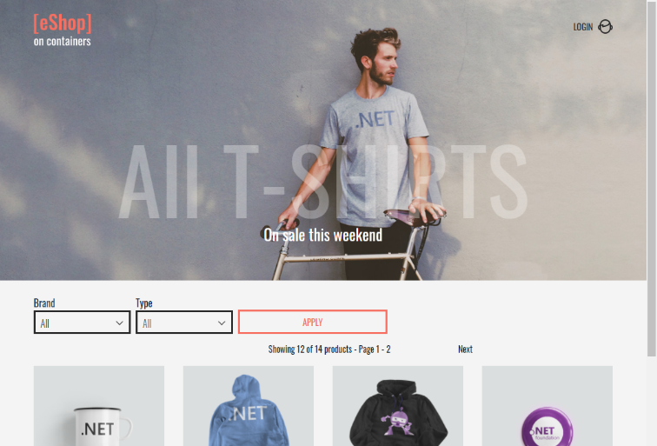
QA – Final Project
Orders Microservice Team
eShopOnContainers by Microsoft
https://github.com/dotnet-architecture/eShopOnContainers

Slide 2
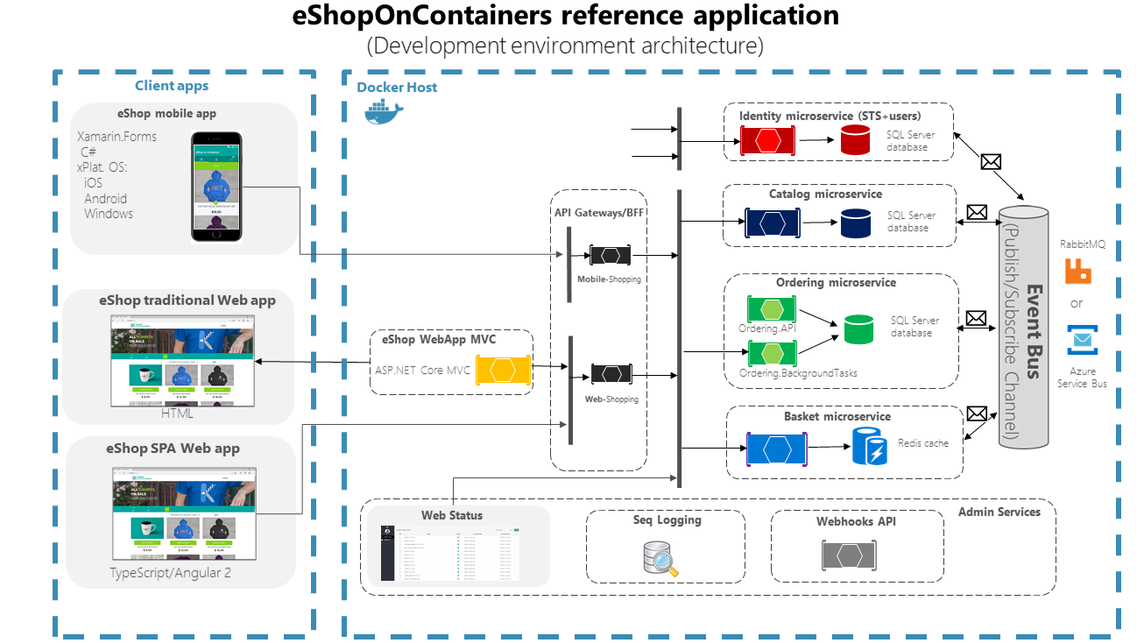
eShop Architecture

Slide 3

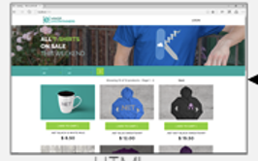



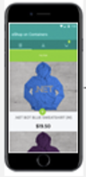

Unit Under Test
GUI
Ordering Service
Identity Microservice
SQL Server database
Catalog Microservice
Ordering Background Tasks
SQL Server database
SQL Server database
Basket Microservice
SQL Server database +n Redis
Ordering API
Payments Microservice
SQL Server database

Slide 4
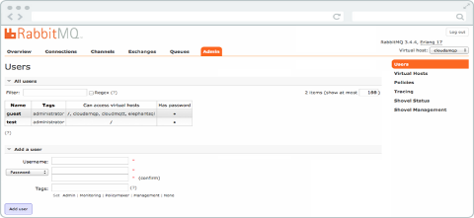


Workspace
GUI
Ordering Service: Unit Under Test UUT
Miocroservices Simulator
Ordering Background Tasks
SQL Server database
Payment
Basket
Catalog
Ordering API
Identity

Slide 5
Order API REST API requests
Get Order (online data)
 | Method | Put
Request | URL | http://host.docker.internal:5102/api/v1/Orders/{OrderId}
 | Bearer Token
 | x-requestid | Unique Guide
 | Request Body | { "orderNumber": 0 }
response | 200 | Success
 | 400 | Bad Request
 | 401 | Unauthorized
 | 403 | Forbidden
2.Ship Order
 | Method | Put
Request | URL | http://host.docker.internal:5102/api/v1/Orders/ship
 | Bearer Token
 | x-requestid | Unique Guide
 | Request Body | { "orderNumber": 0 }
response | 200 | Success
 | 400 | Bad Request
 | 401 | Unauthorized
 | 403 | Forbidden
3.Cancel Order
Order can be cancelled only with statuses (submitted, awaitingvalidation, stockconfirmed)
 | Method | Put
Request | URL | http://host.docker.internal:5102/api/v1/Orders/cancel
 | Bearer Token
 | x-requestid | Unique Guide
 | Request Body | { "orderNumber": 0 }
response | 200 | Success
 | 400 | Bad Request
 | 401 | Unauthorized
 | 403 | Forbidden

Slide 6
Order Flow Description
Basket api service Sends a message to RabbitMQ-> queue:Ordering -> Routing key: UserCheckoutAcceptedIntegrationEvent (Input Messages#1)
Ordering api
Create new Order entity with OrderStatusID =1 in DB
In order remove items form basket, ordering service send a message to RabbitMQ-> queue:Basket -> Routing key: OrderStartedIntegrationEvent (Output Messages#1)
In order create event log, ordering service sends a message to RabbitMQ-> queue:Ordering.Signalrhub -> Routing key: OrderStatusChangedToSubmittedIntegrationEvent (Output Messages#2)
Ordering-Backgroudtasks find the record with OrderStatusID =1 and “ask” from order api to:
Update Order entity Set OrderStatusID =2 in DB
In order to verify that item in stock, a message sent to RabbitMQ-> queue:Catalog -> Routing key: OrderStatusChangedToAwaitingValidationIntegrationEvent (Output Messages#4)
In order create event log, same message has been sent to Ordering.Signalrhub queue. Routing key: OrderStatusChangedToAwaitingValidationIntegrationEvent (Output Messages#3)
In case items in stock:
Catalog Send a message to RabbitMQ-> queue:Ordering -> Routing key: OrderStockConfirmedIntegrationEvent (Input Messages#2)
In order create event log, a message sent to RabbitMQ-> queue: Signalrhub -> Routing key: OrderStatusChangedToAwaitingValidationIntegrationEvent (input Messages#5)
In case items not in stock:
Catalog Send a message to RabbitMQ-> queue:Ordering -> Routing key: OrderStockRejectedIntegrationEvent (Input Messages#3)
In order create event log, a message sent to RabbitMQ-> queue: Signalrhub -> Routing key: OrderStatusChangedToAwaitingValidationIntegrationEvent (Input Messages#5)
Ordering service gets the message from catalog, in case of out-of-stock items:
Update Order entity Set OrderStatusID = 6 in DB and the process is done here
Ordering service gets the message from catalog, in case of in stock items:
Update Order entity Set OrderStatusID = 3 in DB
In Order Create payment, Ordering sends a message to RabbitMQ-> queue:Payment -> Routing key: OrderStatusChangedToStockConfirmedIntegrationEvent (Output Messages#3)
In order create event log, The same message has been sent to RabbitMQ-> queue: Signalrhub
Payment Service gets the message:
In case of payment success:
Payment service send a message to RabbitMQ-> queue: Ordering-> Routing key: OrderPaymentSucceededIntegrationEvent(Input Messages#6)
In order create event log, Ordering sends a message to RabbitMQ-> queue:Payment -> Routing key: OrderStatusChangedToStockConfirmedIntegrationEvent (Output Messages#3)
In case of payment failed, payment service sends a message to RabbitMQ-> queue: Ordering-> Routing key: OrderPaymentFailedIntegrationEvent (Input Messages#7)
Order service gets the message:
In case of success payment:
Update Order entity Set OrderStatusID =4 in DB and process is done here
In case of failure payment
Update Order entity Set OrderStatusID =6 in DB and process is done here

Slide 7
Create Order Flow Scheme
Sends
Order to place
To Ordering queue
Rabbit
MQ
Basket
Simulator
Order created conformation
Ordering
API
Sending message
Catalog
Simulator
Order items In/not in stock
Getting message
Check order items in stock
Update order status to:
2 (awaitngwalidation)
3 (stockconfirmed)
4 (paid)
5 (shipped)
6 (cancelled)
Payment
Simulator
Order payment succeeded/failed
Place Order
From Basket
Order status =
1 (submitted)
Make order payment
New Order found
Check for order with
Status 1
Ordering
Background
Tasks
DB

Slide 8
RabbitMQ Messages and Tools
Input Messages of Ordering API
# | Message Example from Basket Simulator | More Information
1 | { "UserId": "b9e5dcdd-dae2-4b1c-a991-f74aae042814", "UserName": "alice", "OrderNumber": 0, "City": "Redmond", "Street": "15703 NE 61st Ct", "State": "WA", "Country": "U.S.", "ZipCode": "98052", "CardNumber": "4012888888881881", "CardHolderName": "Alice Smith", "CardExpiration": "2024-12-31T22:00:00Z", "CardSecurityNumber": "123", "CardTypeId": 1, "Buyer": null, "RequestId": "097d108a-18e6-4644-b160-bcdd2ef87c18", "Basket": { "BuyerId": "b9e5dcdd-dae2-4b1c-a991-f74aae042814", "Items": [ { "Id": "c1f98125-a109-4840-a751-c12a77f58dff", "ProductId": 1, "ProductName": ".NET Bot Black Hoodie", "UnitPrice": 19.5, "OldUnitPrice": 0, "Quantity": 1, "PictureUrl": "http://host.docker.internal:5202/c/api/v1/catalog/items/1/pic/" } ] }, "Id": "16c5ddbc-229e-4c19-a4bd-d4148417529c", "CreationDate": "2023-03-04T14:20:24.4730559Z" } | Exchange: eshop_event_bus Routing key: UserCheckoutAcceptedIntegrationEvent Data: RequestId: Just Unique ID Items: List of Items (see items schema in Schemas Table)

Slide 9
# | Message Example from Catalog simulator when order items in stock | More Information
1 | { "OrderId": 71, "Id": "e9b80940-c861-4e5b-9d7e-388fd256acef", "CreationDate": "2023-03-07T09:52:56.6412897Z" } | Exchange: eshop_event_bus Routing key: OrderStockConfirmedIntegrationEvent Data: OrderId: Autoincremented ID in DataBase Id: Just Unique id CreationDate: Date created by server
# | Message Example from Catalog simulator when order items NOT in stock | More Information
1 | { "OrderId": 51, "OrderStockItems": [ { "ProductId": 1, "HasStock": False } ], "Id": "99c3f974-c6ed-41a4-8e01-5cb00f9e6335", "CreationDate": "2023-03-05T15:51:11.5458796Z" } | Exchange: eshop_event_bus Routing key: OrderStockConfirmedIntegrationEvent Data: OrderId: Autoincremented ID in DataBase OrderStockItems: List of items in dictionary ProductId: id of item HasStock: Bool of item in/not in stock Id: Just Unique id CreationDate: Date created by server

Slide 10
# | Message Example from Payment simulator when payment succeeded | More Information
1 | { "OrderId": 41, "Id": "b84dc7a5-1d0e-429e-a800-d3024d9c724f", "CreationDate": "2023-03-05T15:33:18.1376971Z" } | Exchange: eshop_event_bus Routing key: Routing key: OrderPaymentSucceededIntegrationEvent Data: OrderId: Autoincremented ID in DataBase Id: Just Unique id CreationDate: Date created by server
# | Message Example from Payment simulator when payment failed | More Information
1 | { "OrderId": 51, "OrderStatus": "stockconfirmed", "BuyerName": "alice", "Id": "cca155c0-4480-4c93-a763-910e54218040", "CreationDate": "2023-03-05T17:07:35.6306122Z" } | Exchange: eshop_event_bus Routing key: OrderPaymentFailedIntegrationEvent Data: OrderId: Autoincremented ID in DataBase OderStatus: Order status in local system (not in DB) BuyerName: Name of user who created order Id: Just Unique id CreationDate: Date created by server

Slide 11
2.Output Messages examples of Ordering API
# | Message Example | More Information
1 | { "UserId": "b9e5dcdd-dae2-4b1c-a991-f74aae042814", "Id": "a2fbc6c0-07cf-4536-a1f5-fc9ede9fec07", "CreationDate": "2023-03-05T13:43:13.8898923Z" } | Exchange: eshop_event_bus Routing key: Routing key: OrderStartedIntegrationEvent Data: id: Just Unique ID
2 | { "OrderId": 31, "OrderStatus": "submitted", "BuyerName": "alice", "Id": "cca359ec-15b0-4a9d-b5fd-44f896f49570", "CreationDate": "2023-03-05T13:43:15.7845974Z" } | Exchange: eshop_event_bus Routing key: OrderStatusChangedToSubmittedIntegrationEvent Data: id: Just Unique ID
3 | { "OrderId": 51, "OrderStatus": "stockconfirmed", "BuyerName": "alice", "Id": "cca155c0-4480-4c93-a763-910e54218040", "CreationDate": "2023-03-05T17:07:35.6306122Z" } | Exchange: eshop_event_bus Routing key: OrderStatusChangedToStockConfirmedIntegrationEvent
4 | { "OrderId": 31, "OrderStatus": "awaitingvalidation", "BuyerName": "alice", "OrderStockItems": [ { "ProductId": 1, "Units": 1 } ], "Id": "1f07939c-8ad2-404b-963f-efe02cb6615a", "CreationDate": "2023-03-05T14:27:28.8042812Z" } | Exchange: eshop_event_bus Routing key: OrderStatusChangedToAwaitingValidationIntegrationEvent

Slide 12
Test Case Example
TC ID | TC001
UUT | Ordering Micro Service (MS)
TARGET | Checking creating normal order
TC NAME | test_create_order
DATE | 05.03.2023
Requirement cover | OR 1
Pre-conditions | Docker containers: Ordering API ,SQLData,Identety, RabbitMQ are runnig and they all working properly.
 | Basket Simulator is working properly.RabbitMQ queues are clean.
Version | RabbitMQ 3.11.10
Author | Artsyom Sharametsieu
Priority | 9
Status | In progress
Platform | Docker 4.17
Cicle | 1
Step numbers | 2
Step | Step description | Actual | Expected | Fail/Passed
1 | Basket Simulator sends message to RabbitMQ Ordering queue to create order |  | Ordering queue got message
2 | Validate order creation in DB |  | Order created in DB with status 1 (submitted)

Slide 13
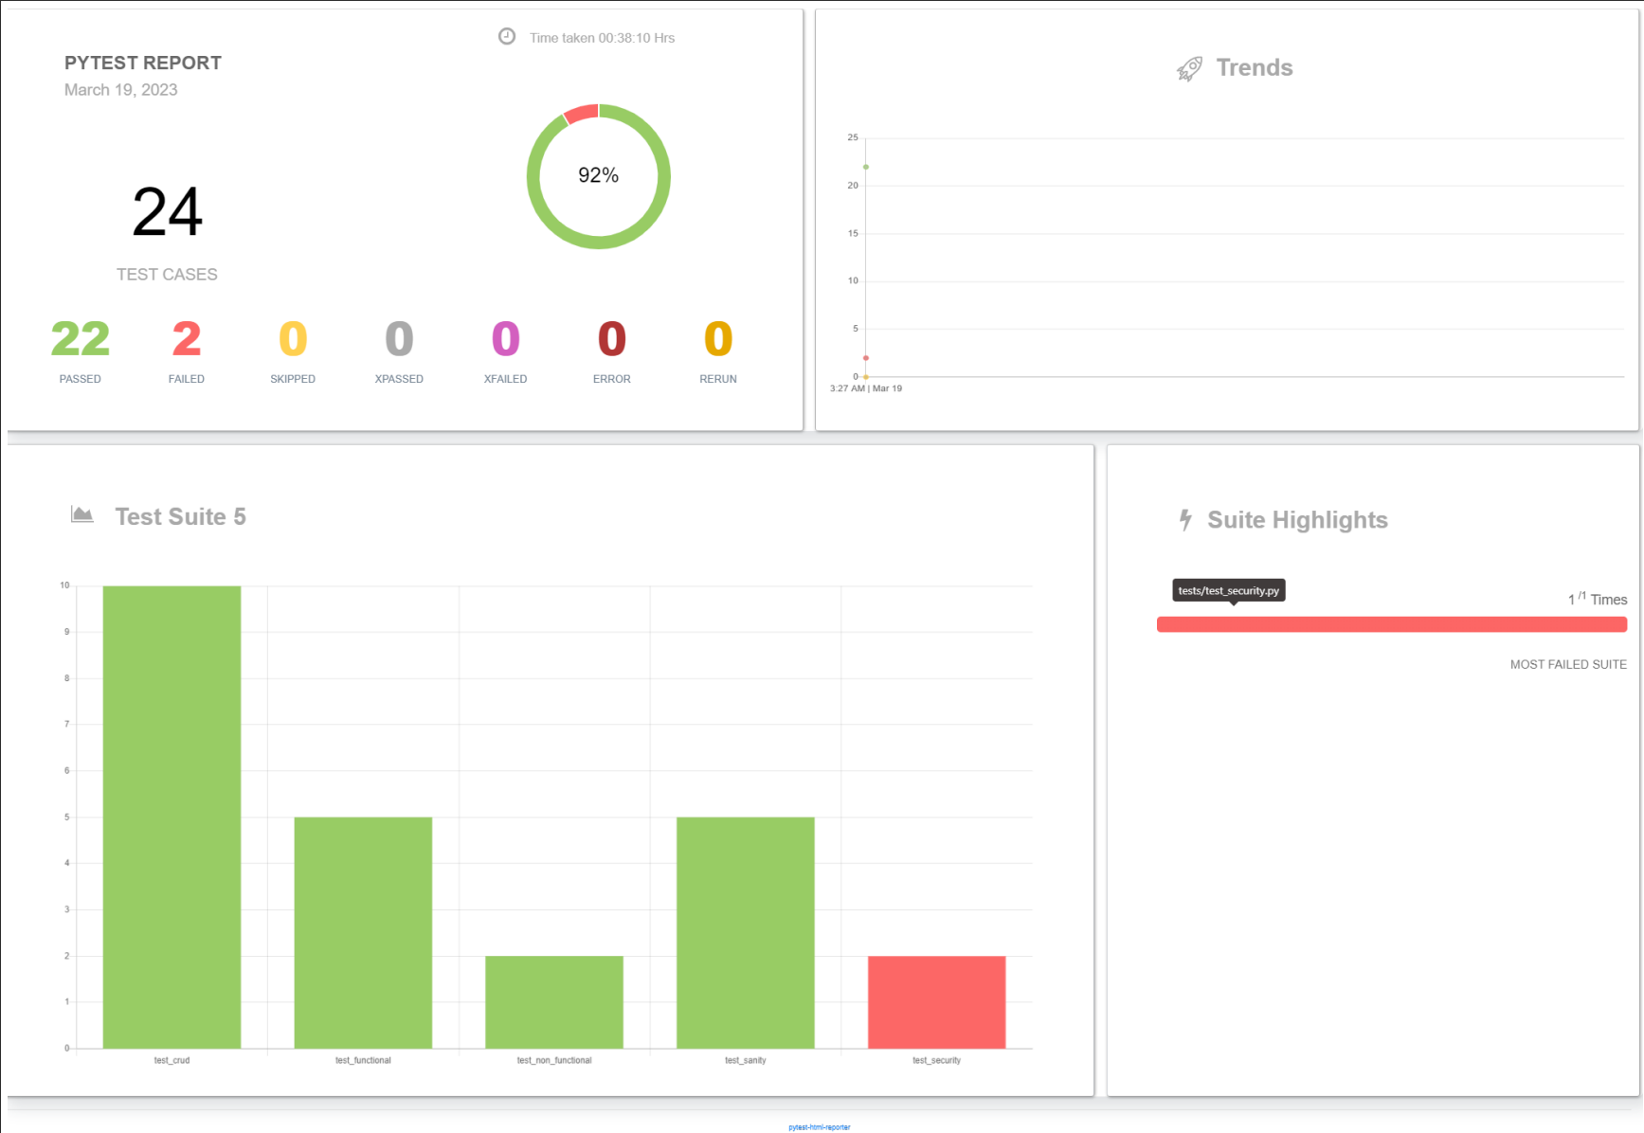

Slide 14
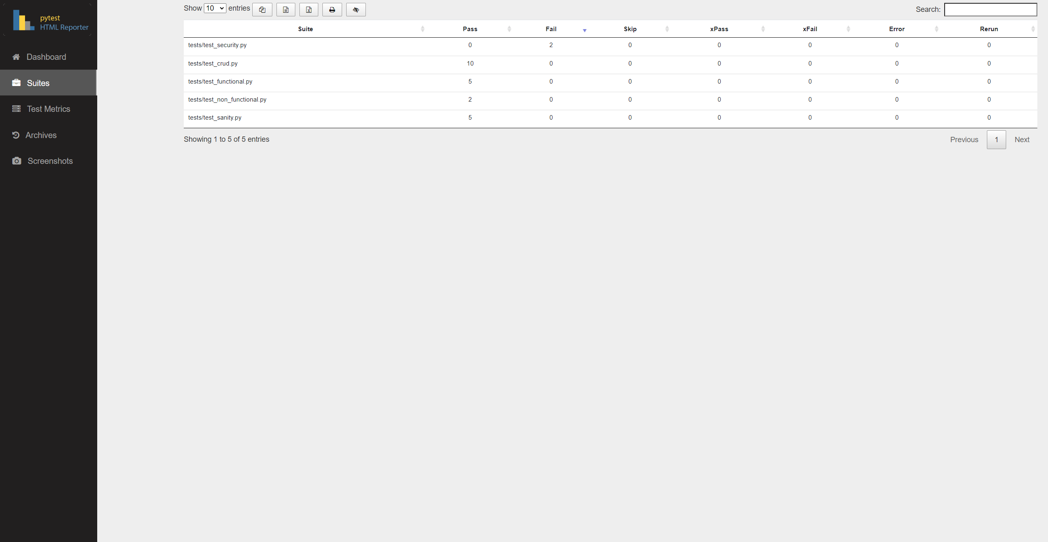

Slide 15
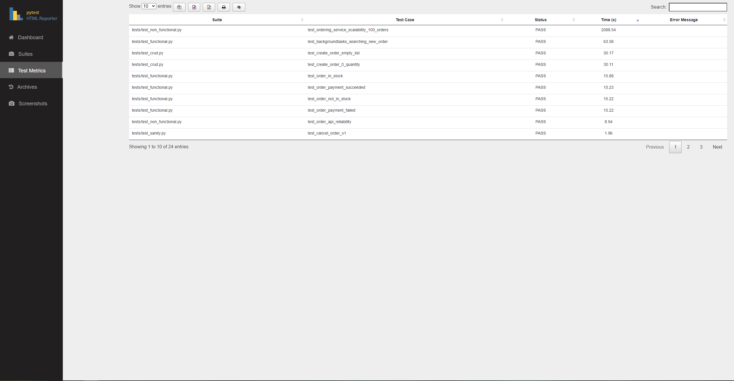

Slide 16
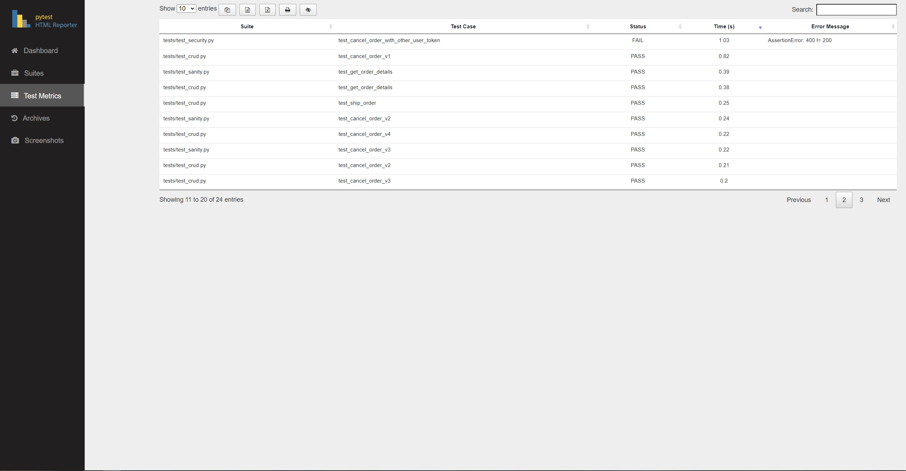

Slide 17
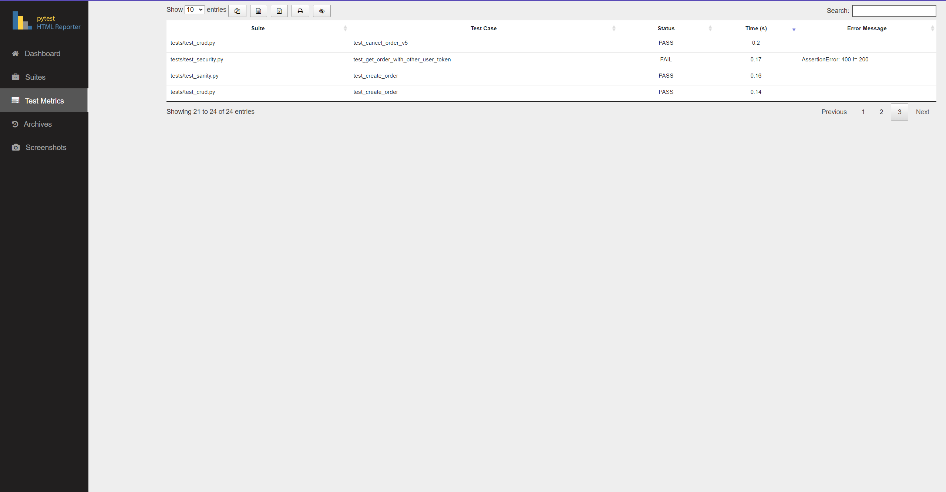

Slide 18
What did I learned or improved?
1. Working with RabbitMQ
2. Working with Docker
3. Skills to write tests
4. Understanding what is microservice and what is simulator
5. Creativity in finding for solutions

Slide 19

Thank you for listening

